Slide 1
ORRA Local Online Brand
Project Manager: Noha Ibrahem
Project Name: ORRA (local online brand)
Group Code: NEXT81_ONL1_ERP8_M1d
ID Number: 21020334

Slide 2
Table of contents
02
01
03
Project Initiation
Business Analysis
involves defining the project's purpose, scope, and objectives to secure approval and resources
assesses organizational needs and defines solutions to improve processes and deliver value
Project Planning
outlines the strategy, timeline, budget, and resources required to achieve project goals effectively.

Slide 3
01
Problem statement

Slide 4
Situation Statements
ORRA is a local online brand that has been operating for two years, selling basic clothing items such as shirts and pants.
Recently, ORRA expanded its offerings to include sportswear, shorts, pajamas, and skincare products.
Current Challenge:The new line has struggled to generate sales
Target Audience
Demographic Focus: Young professionals and active individuals.
Market Need: Affordable, stylish sportswear and effective skincare solutions.

Slide 5
Needs
- Poor Sales: Failure to meet sales targets for the new product line.
- Low-Quality Skincare Products: Customer dissatisfaction due to inconsistent product quality.
- Inability to Attract New Customers: Ineffective marketing strategies have weakened customer acquisition and brand awareness.

Slide 6
Impacts
- Enhanced Customer Experience: By improving the quality of skincare and expanding the clothing line, ORRA will provide high-quality, affordable products that meet daily needs.
- Customer Loyalty & Satisfaction: Offering quality products at reasonable prices will drive loyalty and satisfaction, creating repeat customers.
- Broader Product Selection: Customers will benefit from a wider range of products, making ORRA a one-stop shop for essentials.

Slide 7
Effect
- Increased Sales & Profit: Stronger marketing and better products will boost sales, leading to higher profitability.
- Market Competitiveness: Improved profitability will allow ORRA to compete effectively with other brands.
- Brand Growth: As sales increase, ORRA will be able to expand further, both in product lines and market reach.

Slide 8
02
swot analysis & fishbone diagram

Slide 9
Strengths
- Established Brand Presence: Two years in the market with a loyal customer base for basic clothing.
- Diverse Product Line: Expansion into sportswear and skincare, catering to various customer needs.
- Online Accessibility: Ability to reach customers through an online platform.
Strengths
Weaknesses
- Poor Marketing Strategy: Lack of effective promotional efforts for the new product line.
- Low Product Quality: Subpar quality of skincare products affecting customer satisfaction.
- Limited Brand Awareness for New Line: New products are not well-known among potential customers.

Slide 10
Opportunity
- Market Expansion: Growing demand for sportswear and skincare products.
- Improvement in Marketing: Opportunity to enhance marketing strategies through social media and influencer partnerships.
- Quality Enhancement: Potential to improve product quality, which can lead to better customer retention and satisfaction.
Threats
- Intense Competition: Facing established brands in the sportswear and skincare market.
- Changing Consumer Preferences:* Rapid shifts in trends that may affect product relevance.
- Economic Factors: Economic downturns could impact consumer spending on non-essential items.

Slide 11








CUSTOMER AWARENESS
MARKETING
Inadequate social media engagement
Ineffective communication of benefits
Limited knowledge of new product line
POOR SALES OF NEW PRODUCT LINE
Weak promotional strategies
Lack of online presence
No targeted advertising
Low-quality skincare products
Changes in consumer spending habits
Strong competitors in the market
Inconsistent quality in sportswear
Price wars affecting profit margins
Lack of product testing and feedback
Economic downturn
Established brands with loyal customer bases
PRODUCT QUALITY
COMPETITION
ECONOMIC FACTORS

Slide 12
03
ORRA Smart Goals
Goal 1: Increase Sales Revenue
Original Goal:
Improve sales revenue from the new product line.
SMART Goal:
Increase sales revenue from the new product line by 25% within six months through targeted marketing campaigns and promotions.

Slide 13
Specific:
Focus on increasing sales revenue from the new product line.
Measurable:
Target: Achieve a 25% increase in sales revenue.
Timeframe: Within six months.
Achievable:
Action Plan: Implement targeted marketing campaigns using social media, emails, and promotional strategies.
Relevant:
Directly addresses the issue of poor sales, aligning with business objectives to improve overall sales.
Time-bound:
Deadline: Six months.

Slide 14
ORRA Smart Goals
Goal 2: Enhance Product Quality
Original Goal:
Improve the quality of skincare products.
SMART Goal:
Enhance the quality of skincare products to achieve a customer satisfaction score of 85% or higher within three months by conducting product reviews and gathering customer feedback.

Slide 15
Specific:
Identifies the focus on skincare products for improvement.
Measurable:
Target: Achieve a customer satisfaction score of 85% or higher.
Achievable:
Action Plan: Conduct product reviews, gather customer feedback, and perform internal quality audits after six weeks to ensure progress.
Relevant:
Directly impacts customer satisfaction and sales, making it highly relevant to overall objectives.
Time-bound:
Deadline: Three months.

Slide 16
04
ORRA OKRs

Slide 17
Objective 1: Increase Sales of New Product Line
Key Result 1: Achieve a 25% increase in sales revenue from the new line within six months.
Key Result 2: Acquire 500 new customers for the new product line by the end of the quarter.
Key Result 3: Improve the average order value by 15% through upselling and cross-selling strategies, such as bundling offers or loyalty discounts.

Slide 18
Objective 2: Enhance Product Quality
Key Result 1: Achieve a customer satisfaction score of 85% or higher for skincare products within three months.
Key Result 2: Reduce return rates for skincare products to below 5% by improving quality control processes.
Key Result 3: Implement a customer feedback loop to gather insights on product quality by the end of the quarter.

Slide 19
Objective 3: Expand Customer Awareness
Key Result 1: Increase social media followers by 50% within four months.
Key Result 2: Generate 10,000 new leads through targeted marketing campaigns.
Key Result 3: Achieve a 30% increase in website traffic from organic search and paid ads (e.g., Instagram influencers, Google Ads).

Slide 20
Objective 4: Improve Marketing Strategy
Key Result 1: Launch three new marketing campaigns focused on the new product line within two months.
Key Result 2: Increase engagement rates on social media by 30% through interactive content.
Key Result 3: Achieve a 20% conversion rate from marketing campaigns by optimizing landing pages and calls to action.
Monitor Cost Per Acquisition (CPA) and Click-Through Rate (CTR) to assess campaign performance.

Slide 21
05
Power Grid

Slide 22
high
Keep satisfied (high priority)
Manage closely (high effort)
Project Owner/Manager
Social Media Marketing Specialists
Designer Graphic
Market Research analyst
Quality Comtrol
Customer Support Team
Sales Teams
Quality Control manager
med
Power
UI/UX Designer
Monitor (minimum effort)
Show consideration
Compliance officer
Delivery team
Development Team
Customer support team
Investors
Accountant
low
low
med
high
Interest

Slide 23
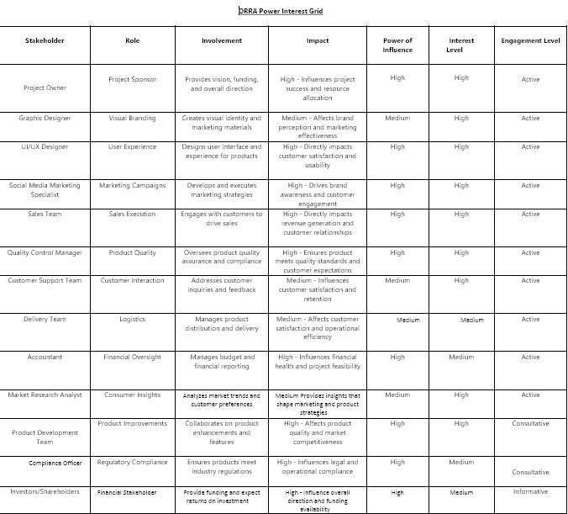

Slide 24
05
RACI Charts

Slide 25
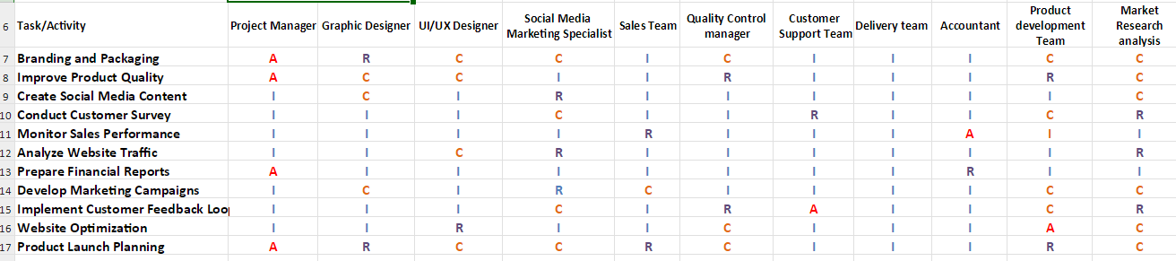

Slide 26
06
Project Charts

Slide 27
Executive Summary
Brief overview of ORRA's current position.
Challenges faced with the new product line (poor marketing and low-quality products).
Aim of the project to improve product quality and marketing strategies.
Project Goal:
Increase sales and improve customer experience.
Enhance product quality and launch effective marketing campaigns.
Scope and Execution
In-Scope:
Product quality improvements, marketing strategy, customer engagement, logistics, website optimization.
Out-of-Scope:
Expansion into international markets, launching a new unrelated product line.

Slide 28
Deliverables
Improved skincare product quality
Targeted marketing campaign
Redesigned branding and packaging
New social media content and website optimization
Customer feedback loop
Quality control processes
Logistics strategy for delivery
Sales performance monitoring
Measuring Success:
Criteria for success (sales growth, customer satisfaction, market reach, website traffic, engagement rate).
ROI expectations.

Slide 29
06
WBS - Work Break Down Structure

Slide 30
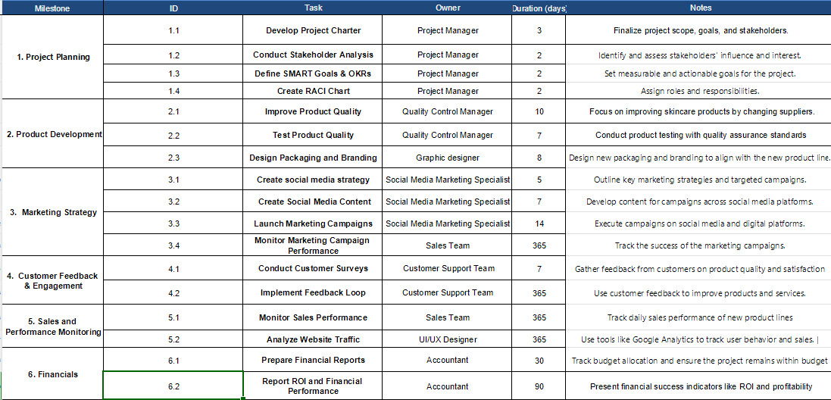

Slide 31
07
Gantt Chart

Slide 32
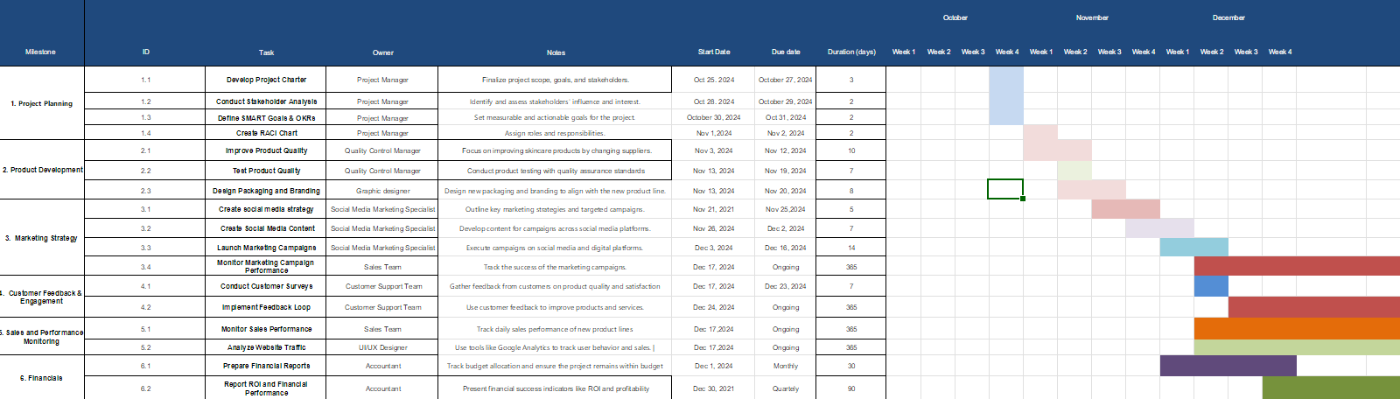

Slide 33
08
Budget Plan

Slide 34
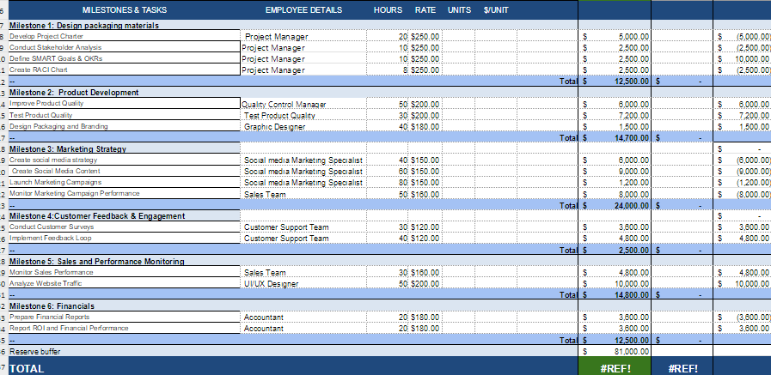

Slide 35
09
Risk Management Plan

Slide 36
Product Quality Issues
Scenario: Poor raw materials lead to subpar skincare products, resulting in higher return rates and customer dissatisfaction.
Risk Level: High
Mitigation Plan:
Implement strict quality control.
Switch raw material vendors.
Test products before launch.
Ineffective Marketing Campaign
Scenario: Marketing campaigns fail to reach the target audience, resulting in poor sales and visibility.
Risk Level: High
Mitigation Plan:
Refine the target audience through market research.
Diversify marketing channels (social media, influencers, paid ads).
Monitor and optimize campaigns based on performance.

Slide 37
Delays in Product Launch
Scenario: Delays in packaging or production affect the product launch timeline.
Risk Level: Medium
Mitigation Plan:
Create a detailed project timeline and monitor milestones.
Ensure suppliers and designers adhere to deadlines.
Budget Overruns
Scenario: Costs exceed the planned budget, particularly in marketing or logistics, reducing profitability.
Risk Level: Low
Mitigation Plan:
Maintain a detailed budget with contingency funds.
Track expenses regularly and adjust allocations.

Slide 38
Low Customer Engagement
Scenario: Customers do not engage with social media content or marketing efforts, reducing brand awareness.
Risk Level: Medium
Mitigation Plan:
Use interactive content like polls and videos.
Collaborate with influencers to reach a larger audience.
Implement a feedback loop to improve engagement.
Monitoring and Continuous Risk Management
Continuous monitoring of risk throughout the project lifecycle.
Regular risk assessments and updates to mitigation strategies.

Slide 39
10
Communication Plan

Slide 40
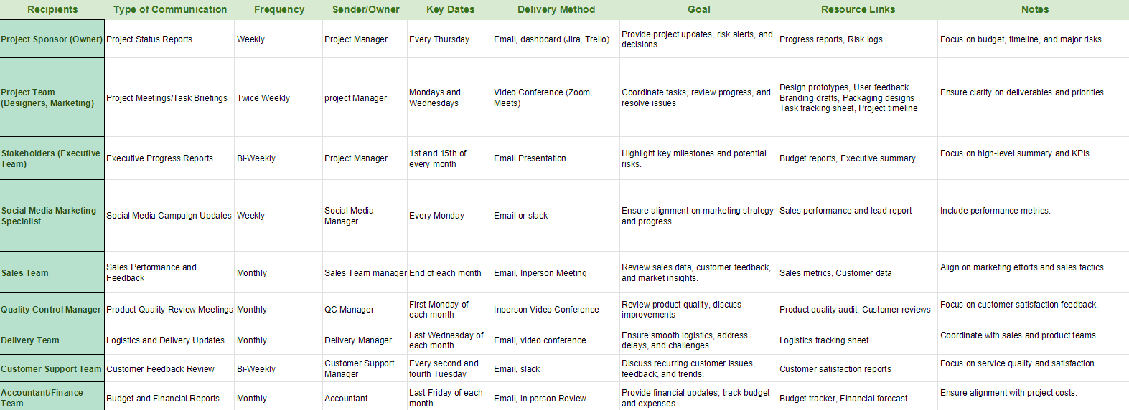

Slide 41
Thank You

